Slide 1
Marketing Attribution with
CoolTShorts
Analyze Data with SQL
Vlad Chuvardynskyi
23.05.2023

Slide 2
Table of Contents
Task 1. Inspect the number of marketing campaigns and sources to run
Task 2. Inspect the page names
Task 3. Calculate first touches for each of campaign
Task 4. Calculate last touches for each of campaign
Task 5. Calculate number users visit 'purchase' page
Task 6. Track number of sales made by each marketing campaign
Task 7. Business decision for running a particular marketing campaign

Slide 3
Company’s objectives
CoolTShirts sells shirts of all kinds, as long as they are T-shaped and cool. Recently, CoolTShirts started a few marketing campaigns to increase website visits and purchases. Using touch attribution, they’d like to map their customers’ journey: from initial visit to purchase. They can use that information to optimize their marketing campaigns.

Slide 4
Marketing funnels and purpose:
Purpose: During this project, we will analyze CoolTShirts database to identify first- and second touches from customers as well as to identify their incentives to purchase beginning from the first visit to the site.
Given: The dataset describes each time a user visits the CoolTShirts website, and it grouped into one SQL table named "page_visits".
The given SQL table includes the following columns:
1. user_id - unique identifier for each visitor to a page
2. timestamp - the time at which the visitor came to the page
3. 'page_name’ - the title of the section of the page that was visited
4. 'utm_source’ - identifies which site sent the traffic (i.e., Google, newsletter, or Facebook ad)
5. 'utm_campaign’ - identifies the specific ad or email blast (i.e., june-21newsletter or memorial-day-sale)

Slide 5
Task 1. Inspect the number of marketing campaigns and sources to run

Slide 6
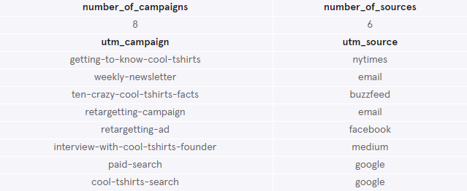
1. Inspect the number of marketing campaigns and sources to run
How many campaigns and sources does CoolTShirts use?
- The CoolTShirts runs 8 unique campaigns through 6 distinct sources
Which source is used for each campaign?
- Each source is used to run each marketing campaign, except the 'email’ and 'google' sources
SELECT
COUNT(DISTINCT utm_campaign) AS number_of_campaigns,
COUNT(DISTINCT utm_source) AS number_of_sources
FROM page_visits;
SELECT DISTINCT utm_campaign, utm_source
FROM page_visits;

Slide 7
Task 2. Inspect the page names

Slide 8
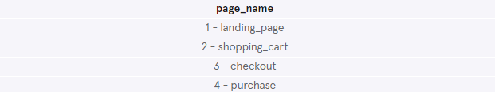
2. Inspect the page names
What pages are on the CoolTShirts website?
- There are 4 unique names of pages on the CoolTShirts website: landing, shopping, checkout and purchase pages
SELECT DISTINCT page_name
FROM page_visits;

Slide 9
Task 3. Calculate first touches for each of campaign

Slide 10
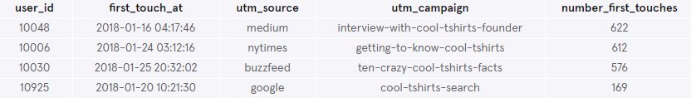
3. Calculate first touches of customers for each of campaign
How many first touches is each campaign responsible for?
Group by campaign and count the number of first touches for each marketing campaign
Example: marketing campaign called ‘interview-with-cool-tshirts-founder’ is advertised on Medium marketing channel and has 622 first touches on it
WITH first_touch AS (
SELECT user_id,
MIN(timestamp) as first_touch_at
FROM page_visits
GROUP BY user_id)
SELECT ft.user_id,
ft.first_touch_at,
pv.utm_source,
pv.utm_campaign,
COUNT(pv.utm_campaign) AS number_first_touches
FROM first_touch AS ft
JOIN page_visits AS pv
ON ft.user_id = pv.user_id
AND ft.first_touch_at = pv.timestamp
GROUP BY utm_campaign
ORDER BY 5 DESC;

Slide 11
Task 4. Calculate last touches for each of campaign

Slide 12
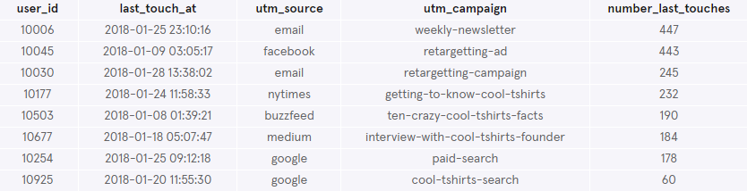
4. Calculate last touches of customers for each of campaign
How many last touches is each campaign responsible for?
Group by campaign and count the number of last touches for each marketing campaign
Example: marketing campaign called ‘weekly-newsletter’ is advertised through email marketing channel and has 447 last touches on it
WITH last_touch AS (
SELECT user_id,
MAX(timestamp) as last_touch_at
FROM page_visits
GROUP BY user_id)
SELECT lt.user_id,
lt.last_touch_at,
pv.utm_source,
pv.utm_campaign,
COUNT(pv.utm_campaign) AS number_last_touches
FROM last_touch AS lt
JOIN page_visits AS pv
ON lt.user_id = pv.user_id
AND lt.last_touch_at = pv.timestamp
GROUP BY utm_campaign
ORDER BY 5 DESC;

Slide 13
Task 5. Calculate number users visit 'purchase' page

Slide 14
5. Calculate number users visit the website's 'purchase' page
Calculate number of users who made the purchases on CoolTShirts website
365 users made purchases on the CoolTShirts website
SELECT COUNT(DISTINCT user_id) AS number_of_purchases
FROM page_visits
WHERE page_name IS '4 - purchase';

Slide 15
Task 6. Track number of sales made by each marketing campaign

Slide 16
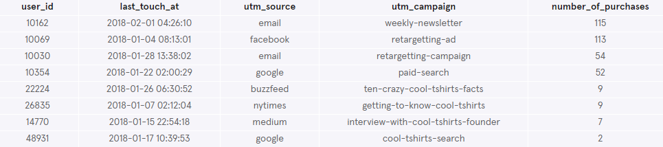
6. Track number of sales made by each marketing campaign
Calculate the number of sales that were made by each marketing campaign
Group by campaign and count the number of purchases done by users for each marketing campaign
Example: marketing campaign called ‘weekly-newsletter’ that is advertised through marketing channel gave incentive for customers to make 115 purchases
WITH last_touch AS (
SELECT user_id,
MAX(timestamp) as last_touch_at
FROM page_visits
WHERE page_name IS '4 - purchase'
GROUP BY user_id)
SELECT lt.user_id,
lt.last_touch_at,
pv.utm_source,
pv.utm_campaign,
COUNT(pv.utm_campaign) AS number_of_purchases
FROM last_touch AS lt
JOIN page_visits AS pv
ON lt.user_id = pv.user_id
AND lt.last_touch_at = pv.timestamp
GROUP BY utm_campaign
ORDER BY 5 DESC;

Slide 17
Task 7. Business decision for running a particular marketing campaign

Slide 18
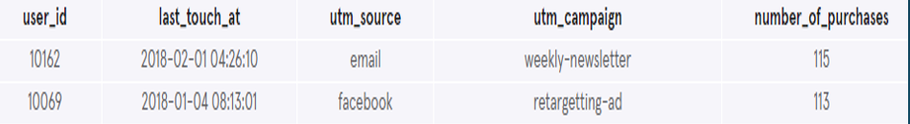
7. Business decision
CoolTShirts can re-invest in 5 campaigns. Which marketing campaigns they should choose and why?
Based on findings from our previous analyses of purchases we can make the following conclusions.
The CoolTShirts company has the highest chance for success by running the 'weekly-newsletter' (through email) and the 'retargeting-ad' (through Facebook) marketing campaigns and therefore the company could re-invest funds into them.

